Slide 1
PRIMs tutorial Unit 1 (continued)
Niels Taatgen

Slide 2
Anatomy of Count
operator start-count {
V1 <> nil // There has to be a visual
WM1 = nil // Imaginal should be empty
==>
V1 -> WM1 // Copy the start number to imaginal slot 1
count-fact -> RT1 // Start retrieving the next number
V1 -> RT2
say -> AC1 // Say the current number
V1 -> AC2
}

Slide 3
Actual chunk representation
start-count
isa operator
slot1 count-fact
slot2 say
condition V1<>nil;WM1=nil
action V1->WM1;C1->RT1;V1->RT2;C2->AC1;V1->AC2

Slide 4
What are PRIMs’ buffers?
V (Visual): input from the task
WM (Working Memory)
G (Goals)
RT (Declarative Memory)
AC (Action)
C (Constants): specific values for an operator
T (Temporal): used for time perception

Slide 5
Two more operators to make it work
operator iterate {
RT2 = WM1
V2 <> WM1
==>
RT3 -> WM1
count-fact -> RT1
RT3 -> RT2
say -> AC1
RT3 ->AC2
}
operator final {
V2 = WM1
==>
say -> AC1
stop -> AC2
stop -> G1
}

Slide 6
Declaration of the Task
define task count {
initial-skills: (count)
default-activation: 1.0
ol: t
rt: -2.0
lf: 0.2
default-operator-self-assoc: 0.0
}

Slide 7
Connect operators to skills
define skill count {
... Operator definitions ...
}

Slide 8
What else do we need?
define facts {
(cf1 count-fact one two)
(cf2 count-fact two three)
(cf3 count-fact three four)
(cf4 count-fact four five)
(cf5 count-fact five six)
}

Slide 9
(cf1 count-fact one two)
cf1
isa fact
slot1 count-fact
slot2 one
slot3 two

Slide 10
Have to define interaction with the task
define script {
digits = ["one","two","three","four","five","six","seven",
"eight","nine","ten"]
start = random(3)
end = start + 1 + random(3)
print("Counting from",digits[start],"to",digits[end])
screen(digits[start],digits[end])
run-until-action("say","stop")
issue-reward()
trial-end()
}

Slide 11
Declarative Memory in PRIMs
Is not just used for facts, but also for operators
The memory mechanisms that were discussed in this morning’s ACT-R lecture are also relevant for PRIMs

Slide 12
Key points
Activation determines:
Order in which we select items
Retrieval time
Activation is composed of:
Baselevel activation
Associative strength

Slide 13
PRIMs associations
Start-Count
Goal
Count
Daydream
Iterate
Final

Slide 14
The PRIMs cycle
Find the most active operator in memory
Test its conditions. If one fails, try the next highest operator
Carry out the actions of the operator
Let the modules perform their actions in parallel
Action, Declarative memory, Working Memory
After the last action is done, repeat

Slide 15
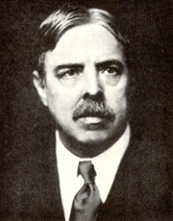
Cognitive modeling/science/psychology view
Each task on its own, little transfer
Identical elements (Thorndike, 1904)

Slide 16

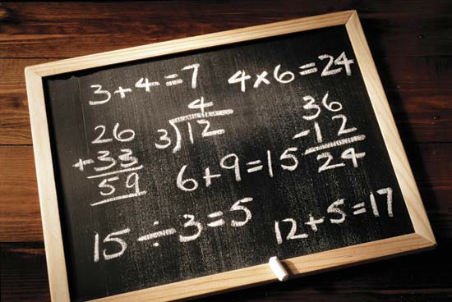
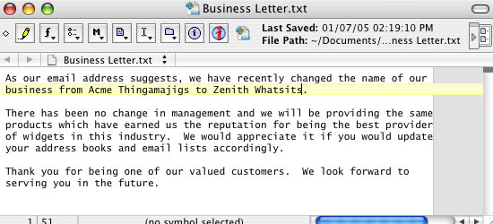
Cognitive skills

Slide 17

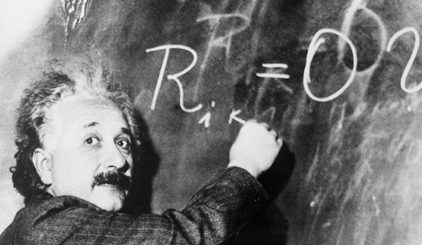

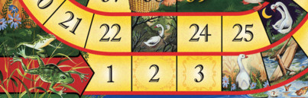
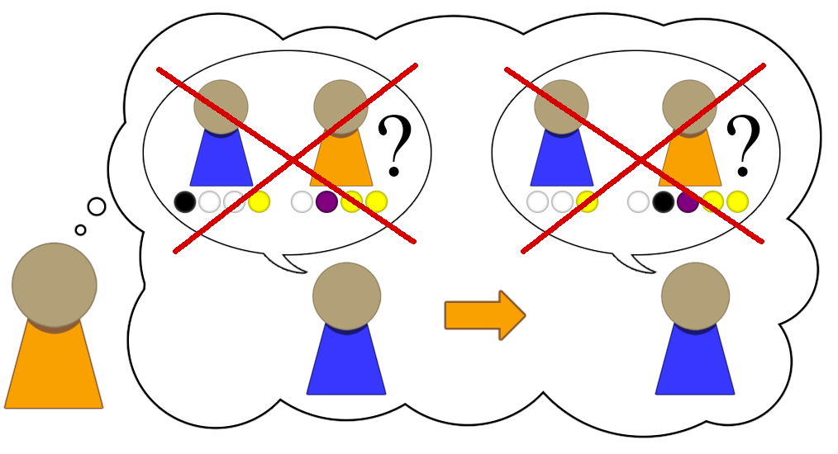





32
19
+ --
51
3 + 2 = 5
A B C ...
Notes:
If we want computers to be intelligent, they will have to start learning like humans. They should start with very simple thinking skills, and build upon these towards increasing complexity. Only then can computers achieve the same incredible mental flexibility that humans have.

Slide 18
Key idea in PRIMs
General Strategies are a byproduct of learning specific skills

Slide 19
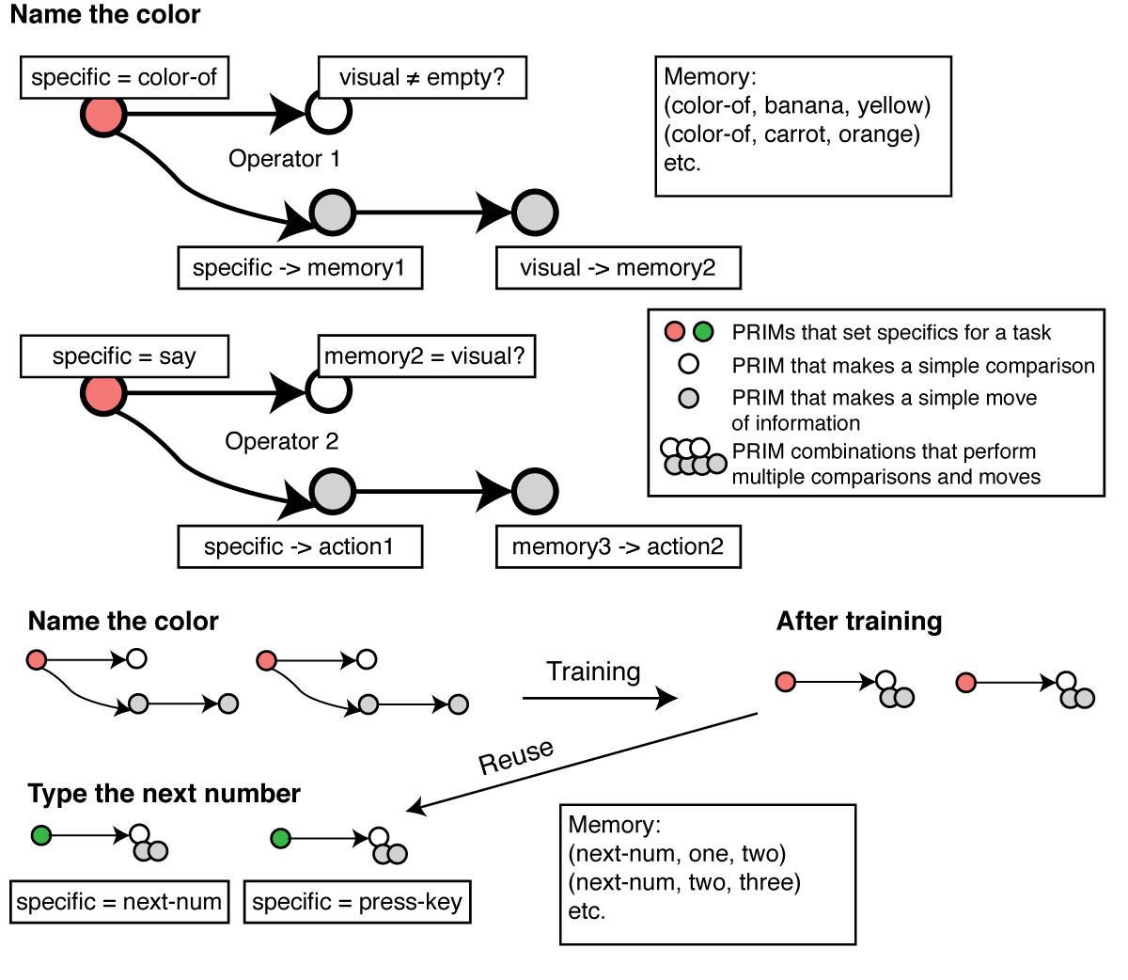

Slide 23
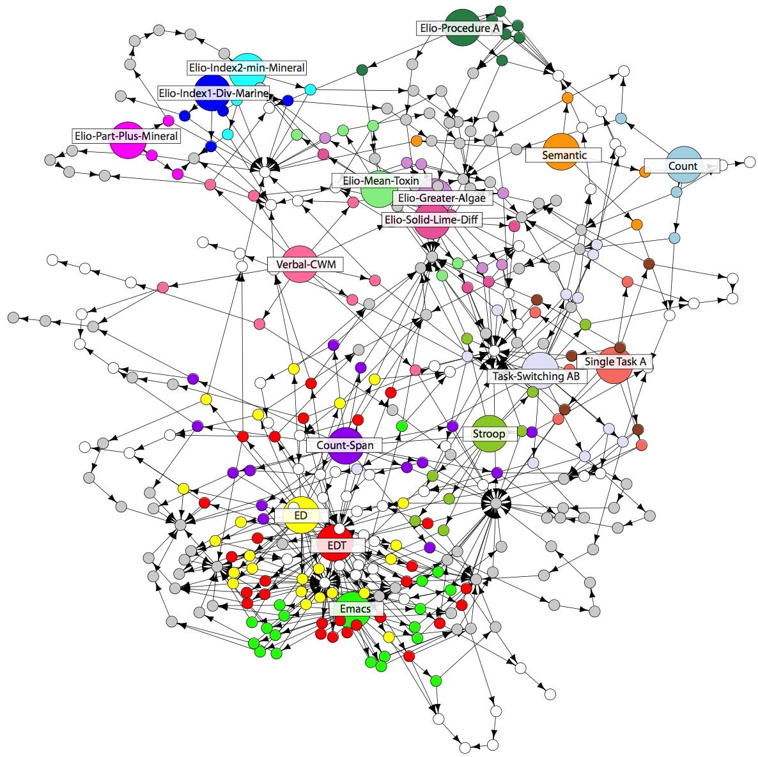
Long term goal: Expand PRIMs into a theory of life-long learning

Slide 24
Possible strategies that can be trained
How to handle task hierarchies and multitasking?
How to control working memory
Rehearsal is a learned strategy, not a brain mechanism
Make decisions while anticipating future consequences of that decision

Slide 25
Accomplishments of PRIMs
Transfer between text editors
Explanation for several brain training experiments (proactive control)
Explanation of why the attentional blink can be trained away
Models of distraction
Models of cognitive development

Slide 26
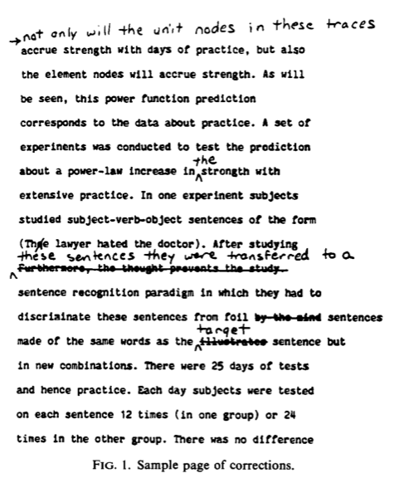
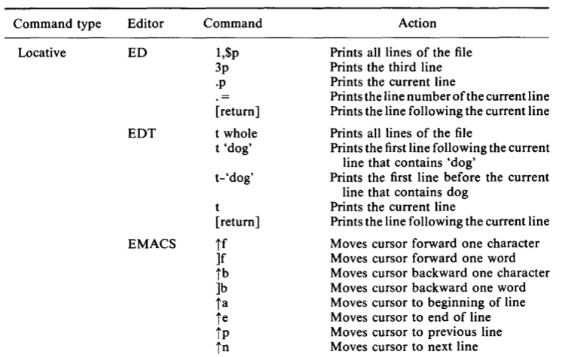
A real example: editors Singley & Anderson 1985

Slide 27
Their findings
Huge transfer between two line editors (ED and EDT)
Smaller, but still decent transfer from line editors to Emacs
Their model: identical productions

Slide 28
Experimental design
6 day experiment
5 conditions, which differed with respect to the editors used
ED – ED – EMACS
EDT – EDT – EMACS
ED – EDT – EMACS
EDT – ED – EMACS
EMACS – EMACS - EMACS

Slide 29
Data from that experiment

Slide 30
Model of this task
Borrows from Singley & Anderson 1985, who borrowed from Card, Moran & Newell 1983
Basic structure
Go to the relevant line for the next edit
Do the edit in that line

Slide 31
The model
Each editor has its own operators in declarative memory
However, there is overlap in the task-general (“gray”) chunks

Slide 32
Overlap between the three models
Ed and Edt are very similar, except for the strategy to move multiple lines and the particular keys that are used
Emacs has the same global strategy, but differs in the details
This is reflected in the model in that Ed and Edt share more of the specific condition and action chunks.

Slide 33
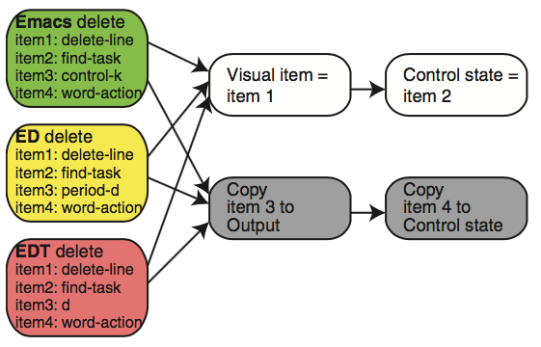
Identical: delete a line

Slide 34
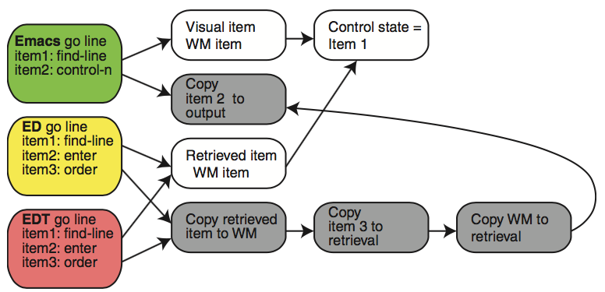
Somewhat different: Move to the right line

Slide 35
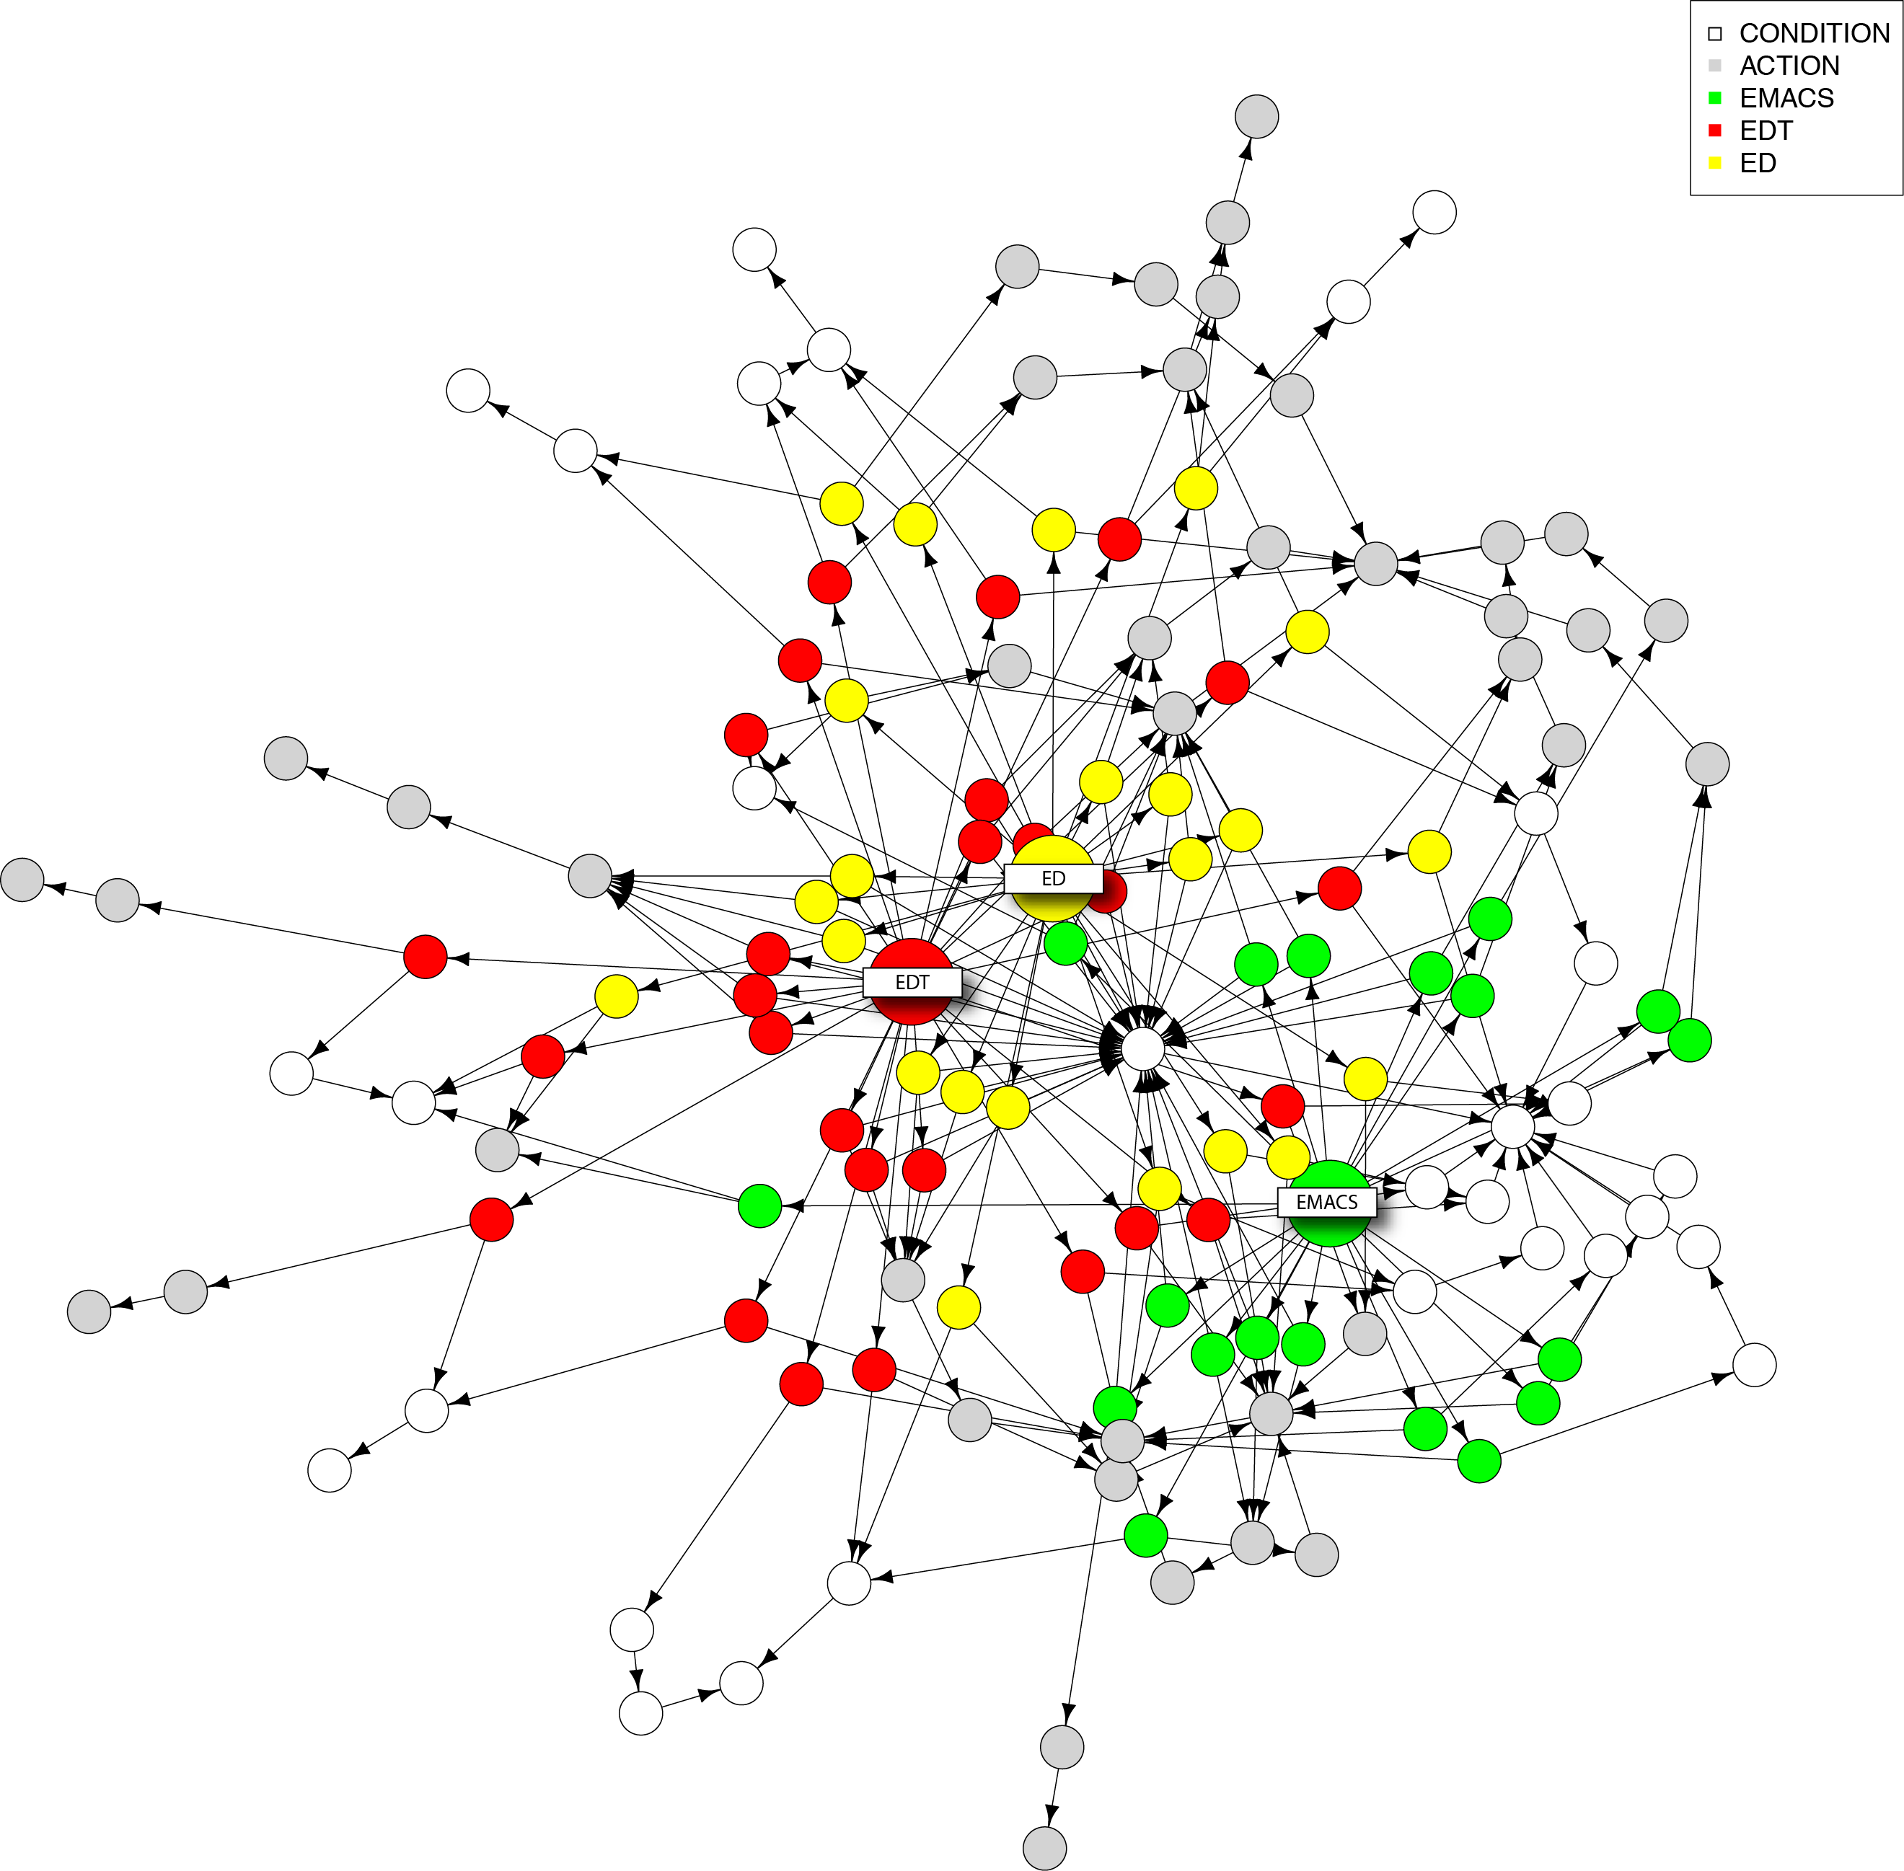

Slide 36
Transfer data/model comparison
Training condition | Human data | Identical productions | PRIM model
Line editor to other Line editor | 95% | 79% | 88%
Line editor to Emacs | 61% | 33% | 61%

Slide 37
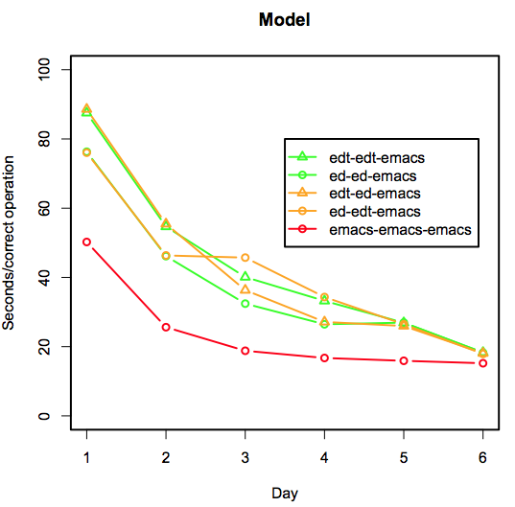
Model results

Slide 38
Difference between PRIMs and identical productions
PRIMs is consistent with the idea of identical elements
But the elements are smaller
Identical productions was not a real processing model

Slide 39
Assignment
Implement addition
Two versions
the “standard” (ACT-R unit 1) version
Adding using fingers as external memory

